Slide 1



Decentralized Census System
Group Members:
Fazeel Ahmed Khan (2K19/SWE/35)
Muhammad Sharjeel Khan (2K19/SWE/72)
Talha Shaikh (2K19/SWE/73)
Supervised By:
Dr. Sir Lachman Das Dhomeja

Slide 2
Introduction
Population Census is one of the most widely known strategic plans that dates back to 3800 BCE.
Questionnaires, interviews, long form / short form, registered-based are some of widely known approaches for census.
Even though some countries did take the approach of digital census and succeeded to a certain degree, they still haven’t gone fully digital.
Our System not only intended to digitalize the process of population census for the most part but also decentralize this entire approach.

Slide 3
Objectives
Reducing the hectic process of conducting census
Reducing potential errors that were caused either deliberately or not.
A mobile application to let users to register themselves which stores a unique key on Blockchain

Slide 4
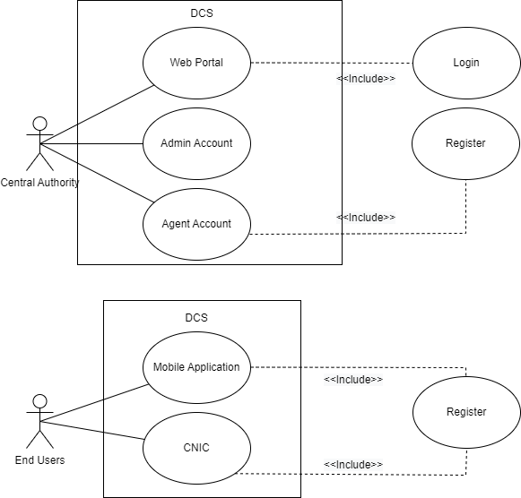
Use Case:

Slide 5
Scope
Scope of this project is limited to nationwide. International census is exempt from this.
This project is solely created to improve Pakistan’s situation of data manipulation.
Not only that, it will reduce expenses and workload by a huge which is another big hurdle when it comes to conducting census.

Slide 6
Methodology
Our system is based on Agile Methodology.
We tested every screen we used in our application one at a time.
Re configure the designs and fixed the bugs presented.
Create APIs and check their workability as we progress through with the UI.

Slide 7
Implementation and Remaining Process
We are done with the UI of Mobile Application.
Database is ready and has been integrated with Mobile Application.
Testing is still underway since we are facing some bugs.
Web portal is currently being worked on and will be done within a week or so.
We haven’t touch Blockchain side of things yet but it will soon be implemented.

Slide 8
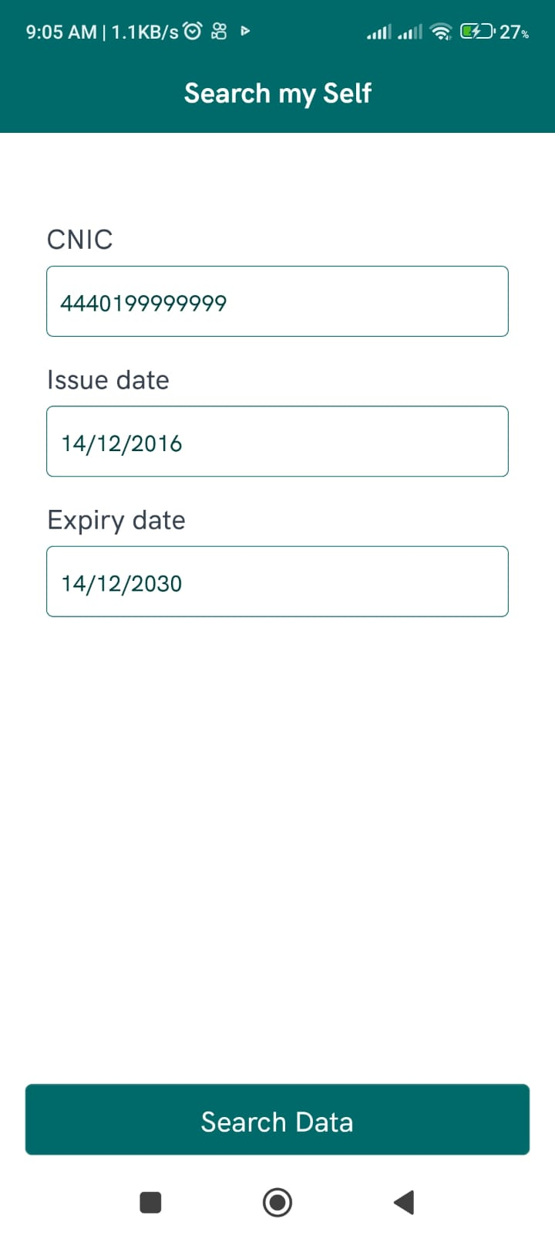
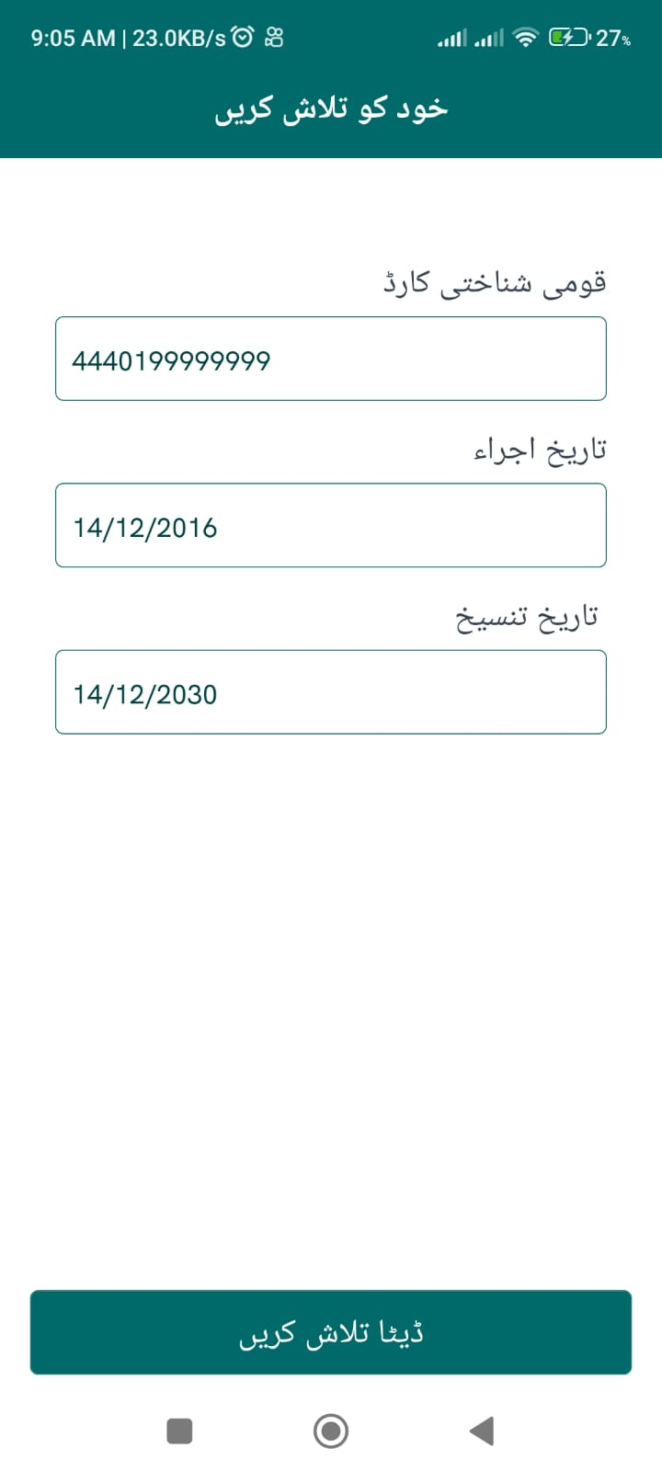
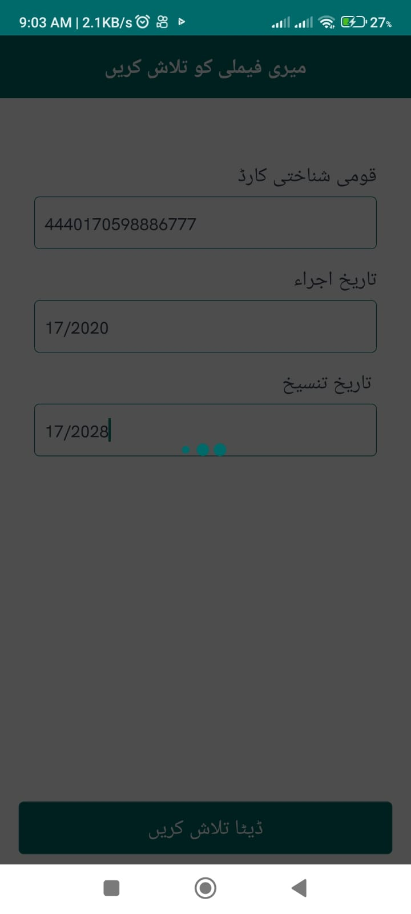
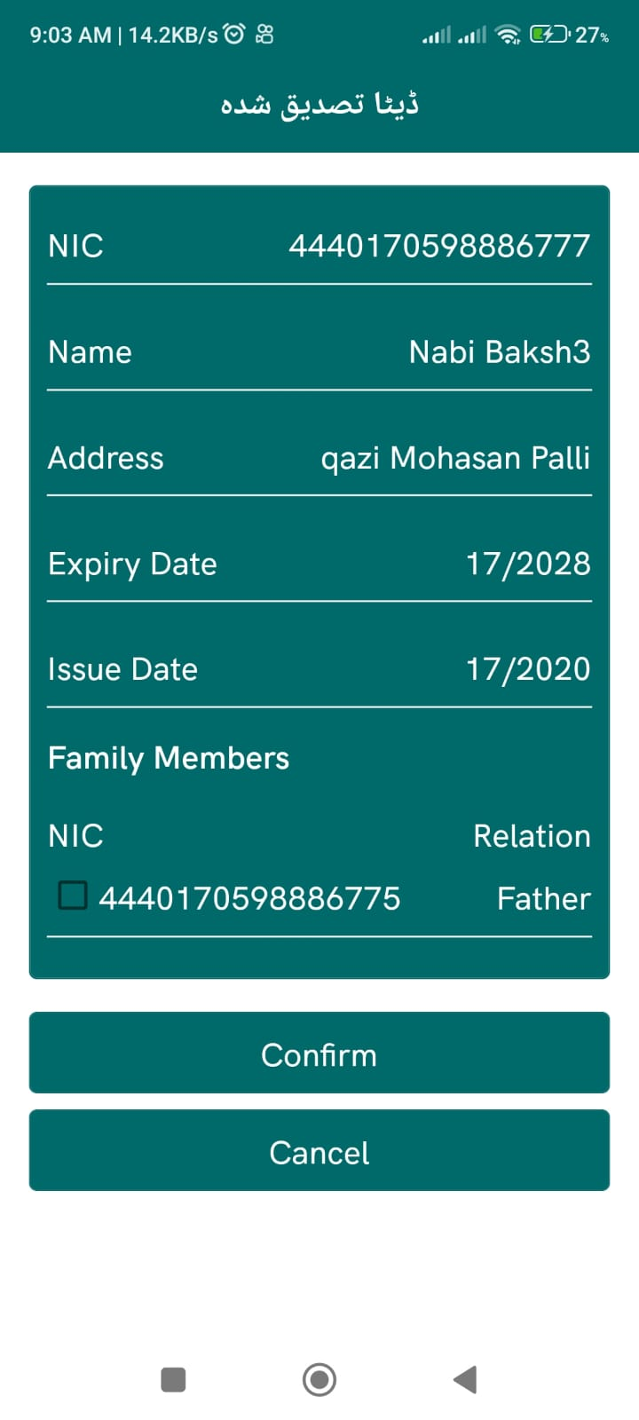

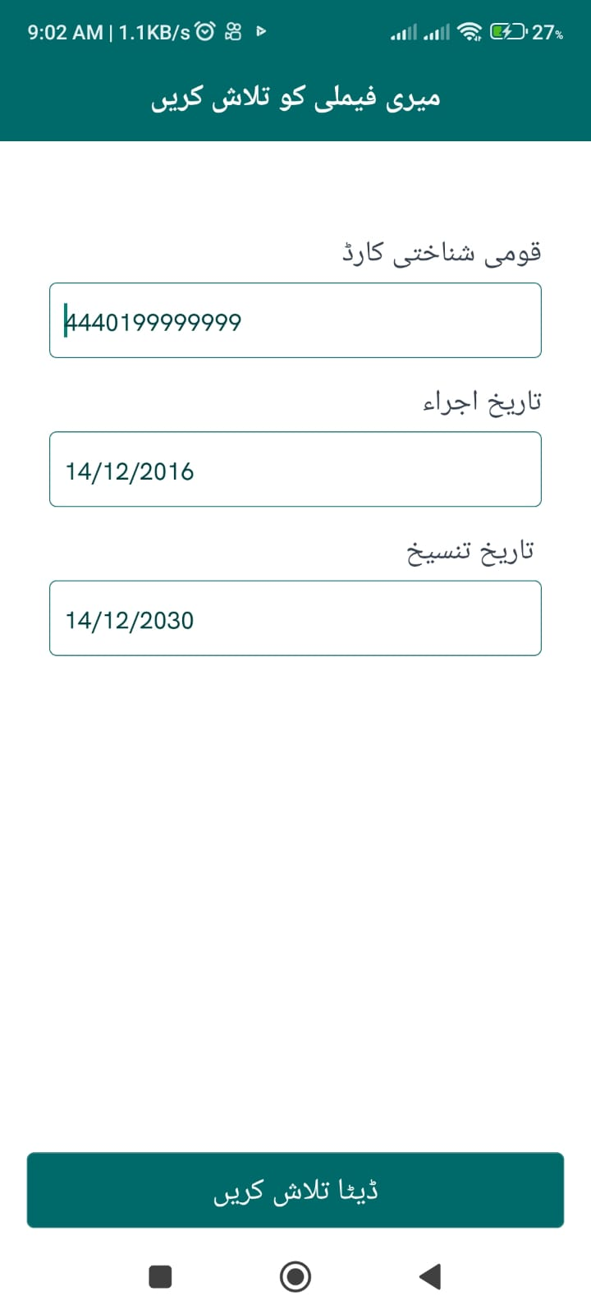
Work Progress

Slide 9
Thank You!
Any Questions?

